Slide 1
Introduction to Concurrent Programming with GPUs
C++Laboratory and Assignment Project Structure

Slide 2
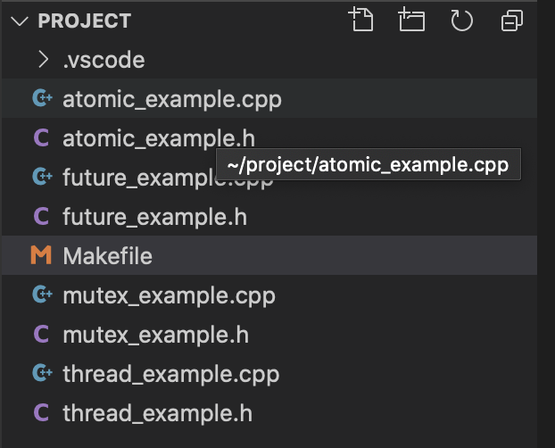
C++ Programming Lab Examples Folder
There are pairs of example C++ code and headers for each major parallel programming C++ STL class.
The Makefile in conjunction with the make command will clean, compile, and execute each example separately.
Notes:
This directory will be under coder user’s project folder.
There are 4 pairs of header and code files for C++ STL code to examine threads, mutexes, futures, and atomics.
The Makefile will be described in the next slide but it will perform numerous operations on the above mentioned code.

Slide 3
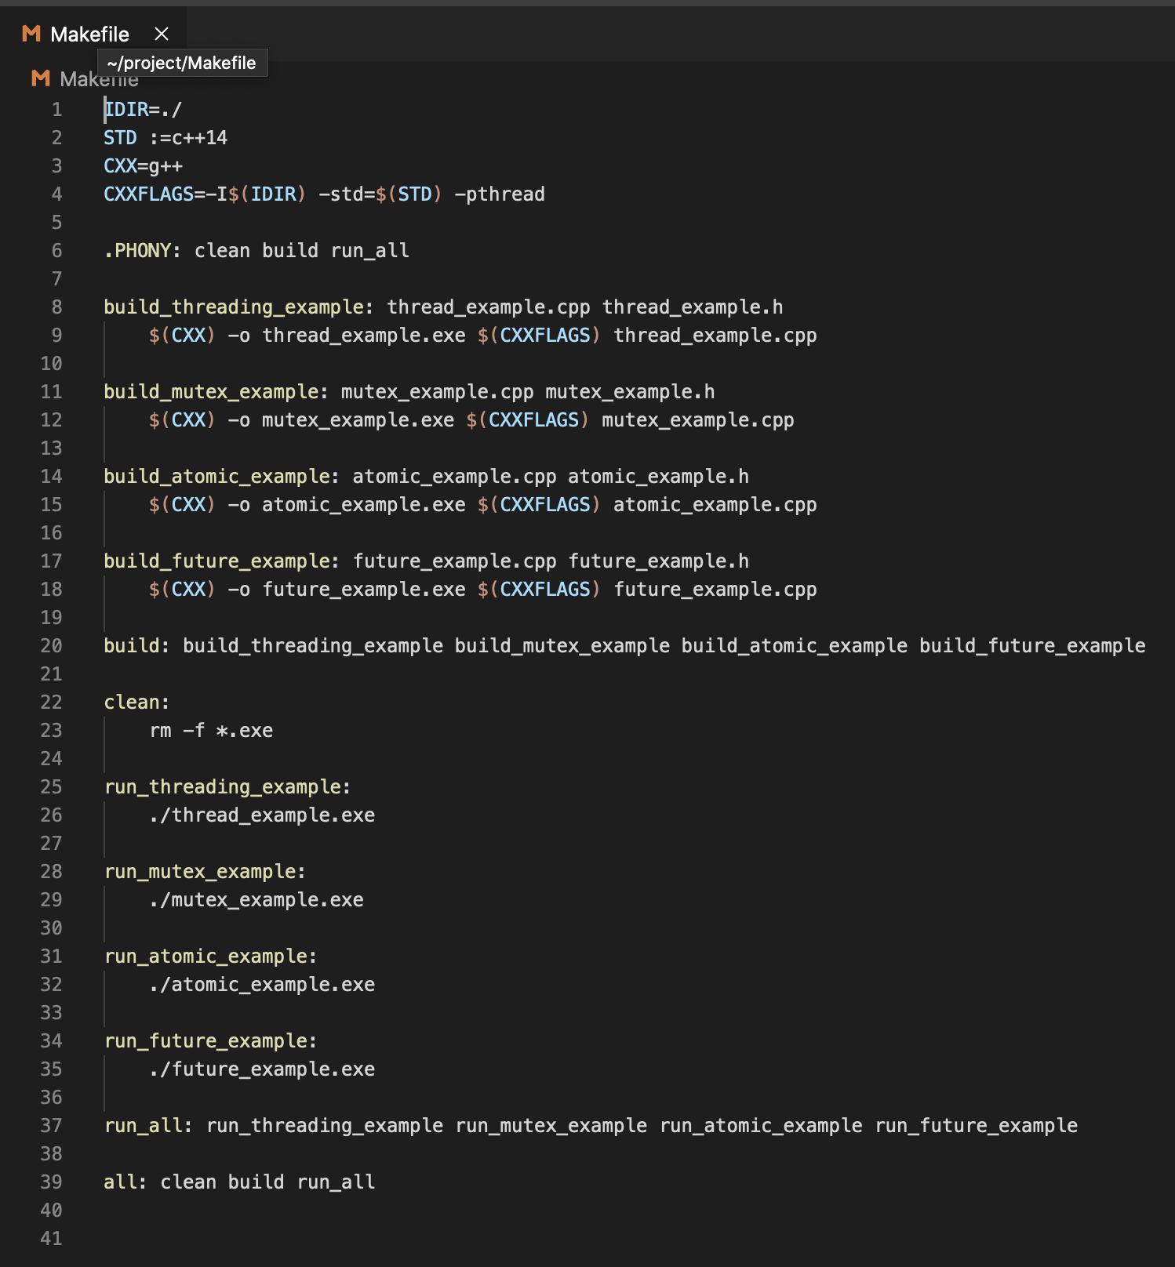
C++ Programming Lab Makefile
The variables (in CAPS) are used in the compilation process
There are 4 example-specific build targets and the build command builds all
The clean target removes all build artifacts
There are a number of run targets, with run_all executing all examples
The all target will clean, build, and run all parts of the C++ example
Notes:
The Makefile for the C++ examples manages compilation of code, running of associated executables and then cleaning of artifacts such as object and executable files created during the build process.
For each example, there is a build and run target and overall build and run_all targets used to build all examples and then run them.
The all target executes all of the applicable targets.

Slide 4
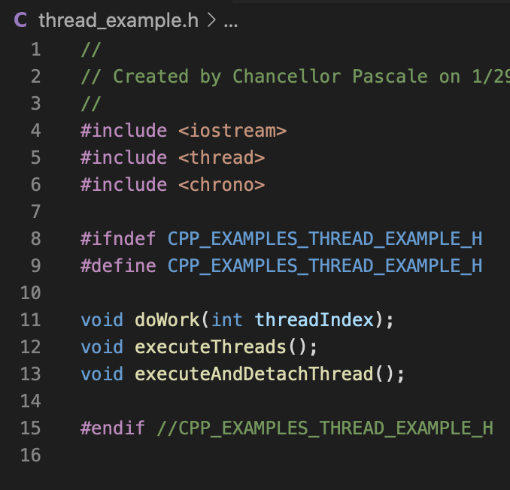
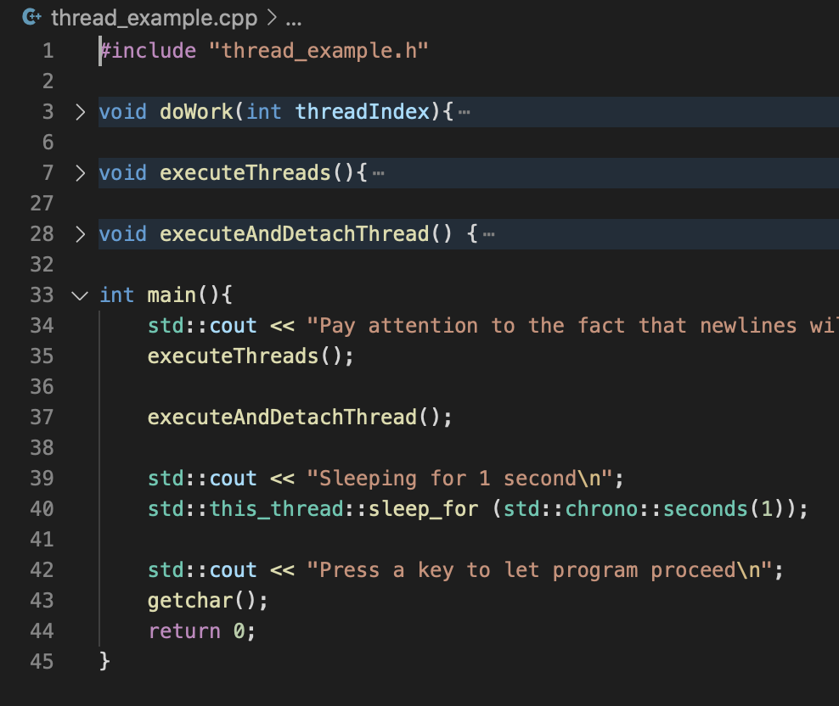
C++ Programming Lab thread Example
Notes:
On the left is the header file for the thread example code.
It contains the function signatures for the 3 non-main functions
On the right is the example code for threads.
There are 3 functions that have been implemented: doWork, executeThreads, executeAndDetachThread.
doWork is a function that holds the executable work for a thread, in this case logging and sleeping the thread.
executeThreads executes a predetermined number of threads in parallel.
executeAndDetachThread executes a thread in detached mode, meaning it is no longer bound to the calling context.

Slide 5
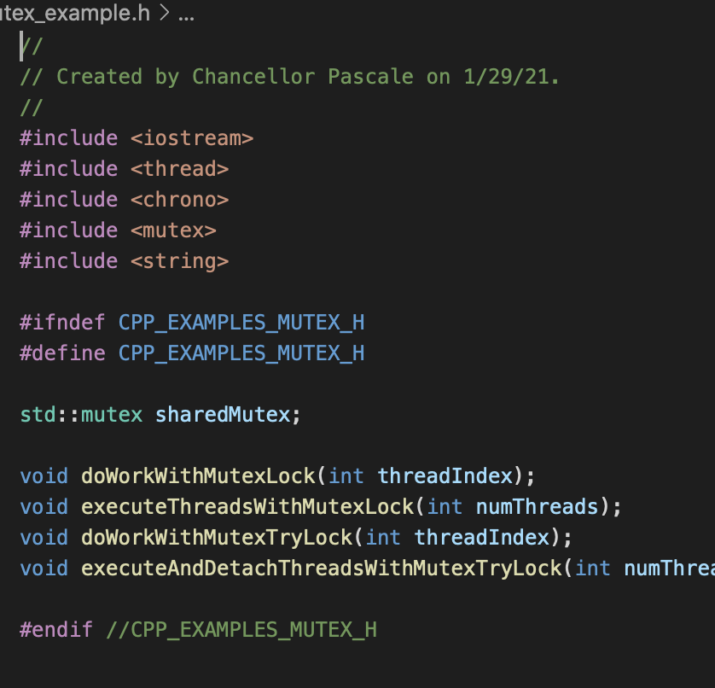
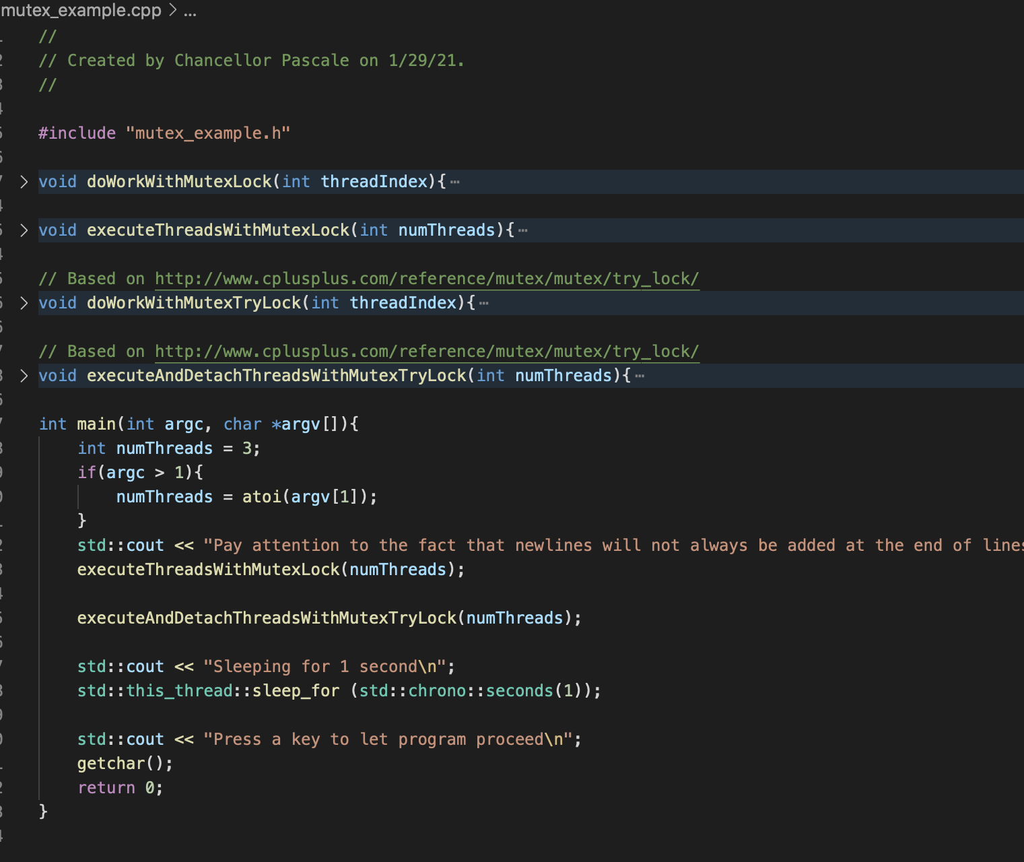
C++ Programming Lab mutex Example
Notes:
On the left is the header file for the mutex example code.
It contains an mutex variable and the function signatures for the 4 non-main functions
On the right is the example code for atomic variables.
There are 4 functions that have been implemented: doWorkWithMutexLock, executeThreadsWithMutexLock, doWorkWithMutexTryLock, executeandDetachThreadsWithMutexTryLock.
The two doWork functions do the work of a single thread with respect to the shared mutex.
The two execute functions execute the doWork on the number of threads passed as a variable, running them in parallel.

Slide 6
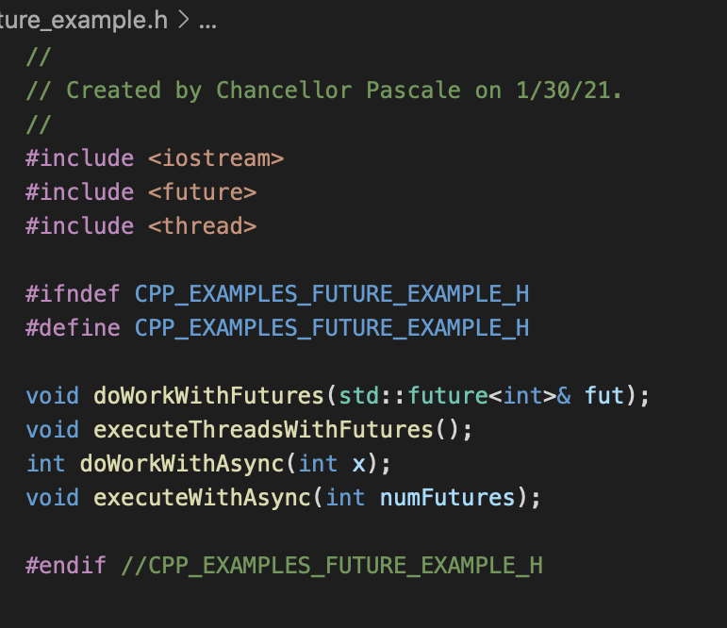
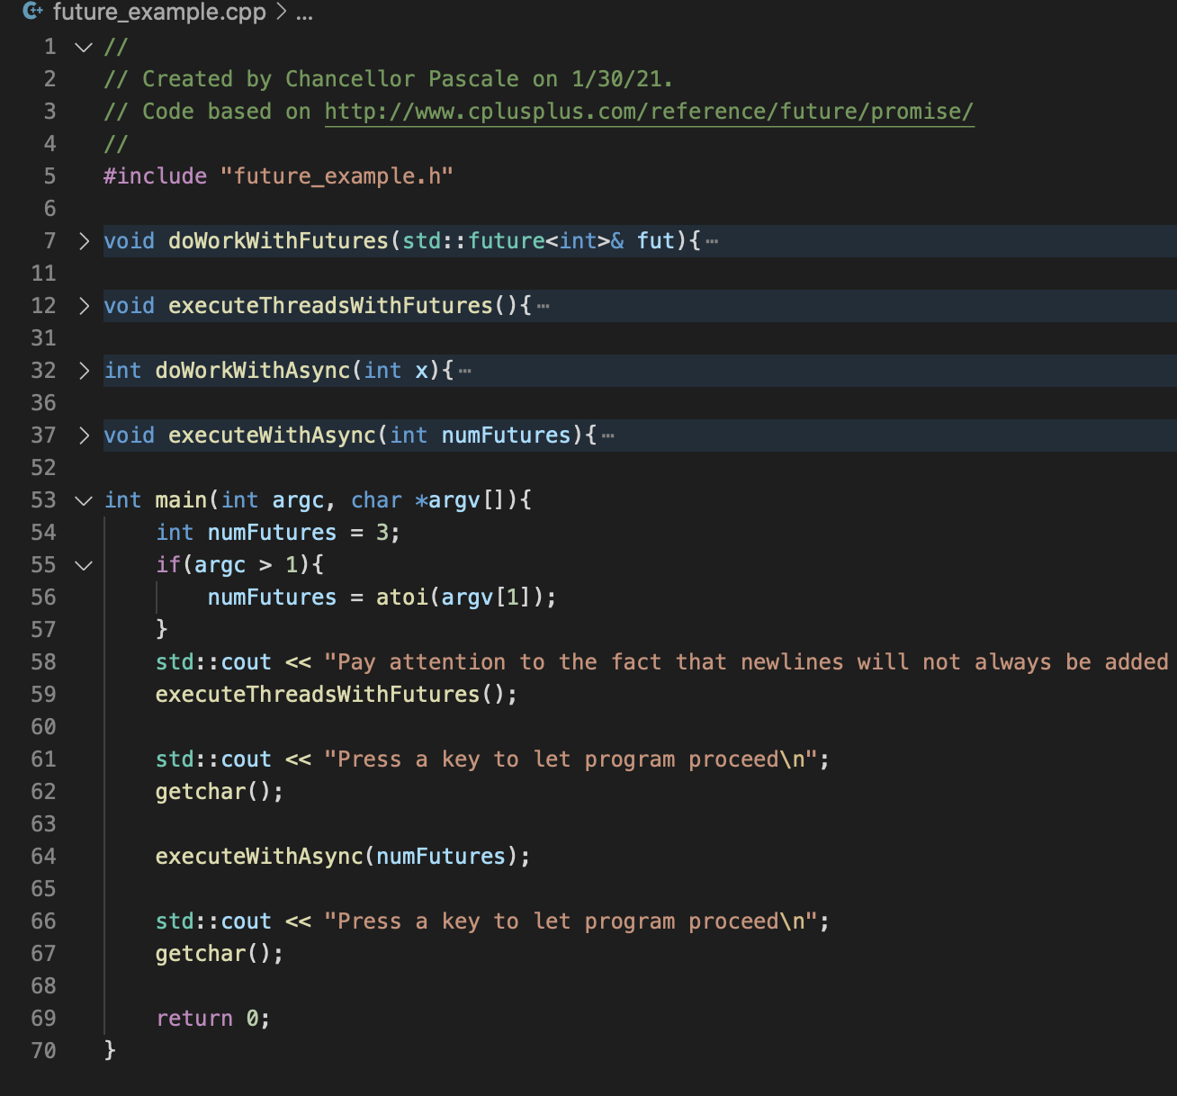
C++ Programming Lab future Example
Notes:
On the left is the header file for the future example code.
It contains the function signatures for the 4 non-main functions
On the right is the example code for futures and async functions.
There are 4 functions that have been implemented: doWorkWithFutures, executeThreadsWithFutures, doWorkWithAsync, executeWithAsync.
The two doWork functions do the work of a single thread with respect to futures and and integer as inputs.
The two execute functions execute the doWork a predetermined or based on a passed number of futures, executing the doWorkWithAsync function asynchronously.

Slide 7
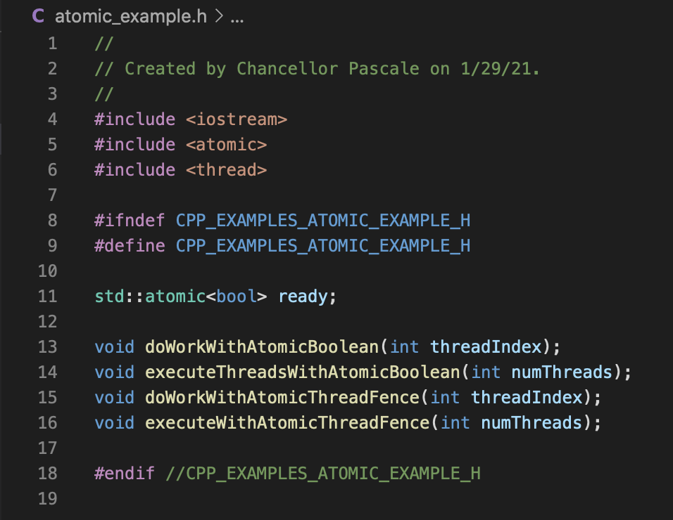
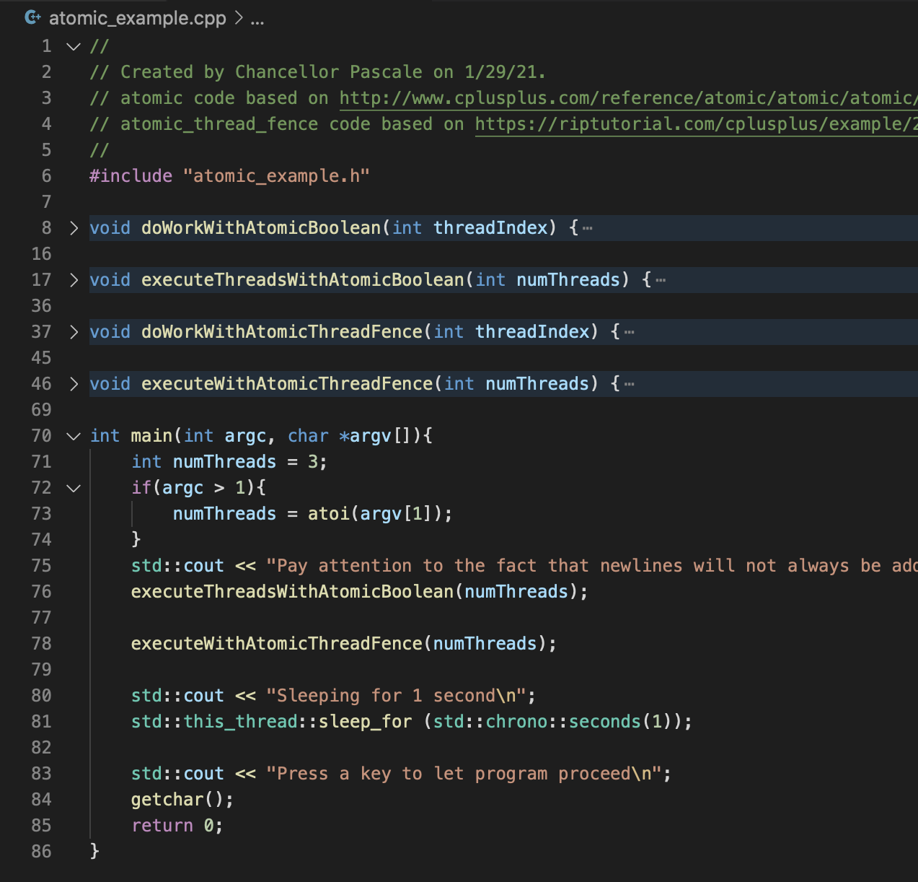
C++ Programming Lab atomic Example
Notes:
On the left is the header file for the atomic example code.
It contains an atomic Boolean variable and the function signatures for the 4 non-main functions
On the right is the example code for atomic variables.
There are 4 functions that have been implemented: doWorkWithAtomicBoolean, executeThreadsWithAtomicBoolean, doWorkWithAtomicThreadFence, executeWithAtomicThreadFence.
The two doWork functions do the work of a single thread with respect to the used atomic variable.
The two execute functions execute the doWork on the number of threads passed as a variable, running them in parallel.

Slide 8
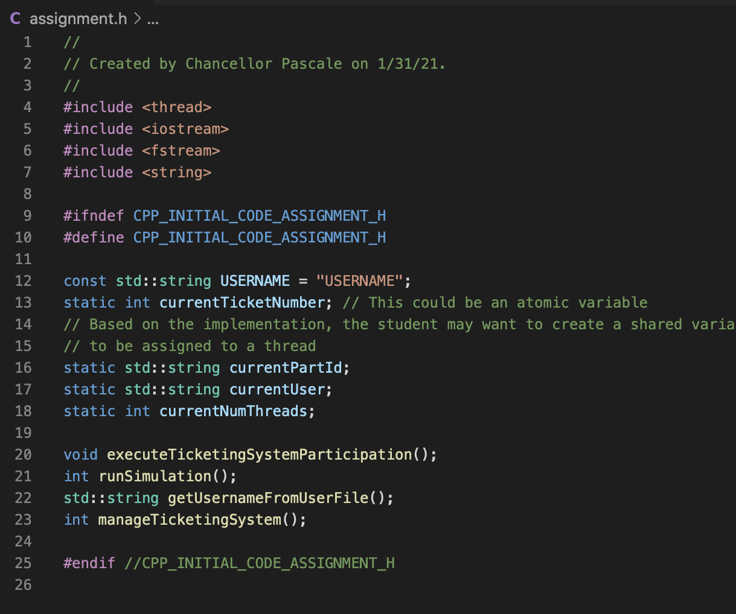
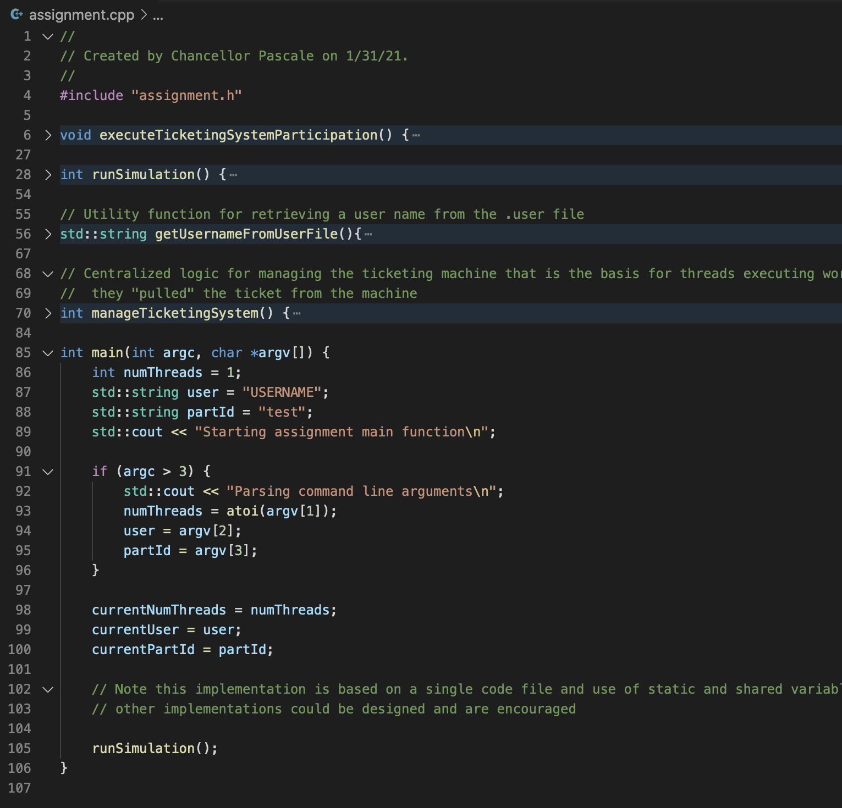
C++ Programming Assignment .h & .cpp
Notes:
On the left is the header file for the assignment code.
There are numerous static variables used in execution of the various functions of the assignment code.
There are also 4-non main functions which are defined in the assignment.cpp file
On the right is the general structure for the assignment code.
There are 4 functions that have been implemented: executeTicketingSystemParticipation, runSimulation, getUsernameFromUserFile, managingTicketingSystem.
The runSimulation function executes a run of the assignment simulation, based on the previously identified static variables in the header file.
Within the runSimulation function the first function called is the getUsernameFromUserFile, which retrieves the current username from the .user file, the executeTicketingSystemParticipation function and the manageTicketingSystem function.
The executeTicketingSystemParticipation function is run by each thread to show that they have entered and executed the critical section of code in ticket order (though they need no knowledge of the required order).
The manageTicketingSystem function manages the ticketing system such that threads execute their work in the order that tickets are retrieved.

Slide 9
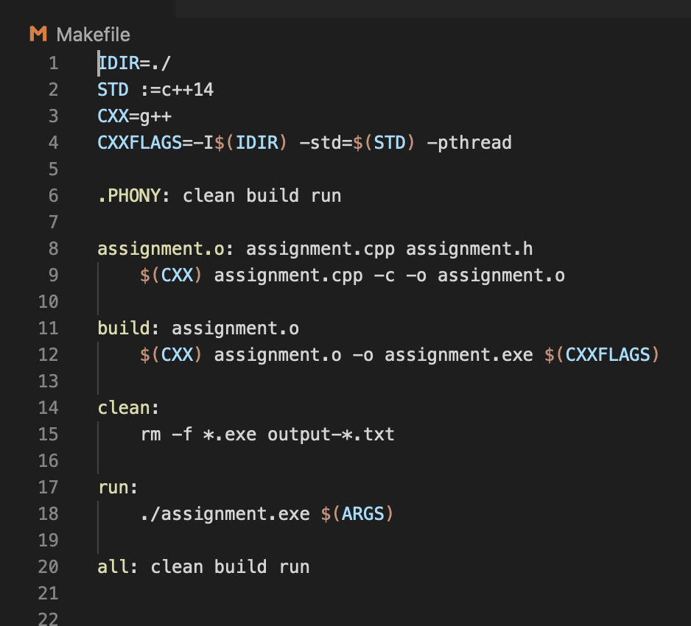
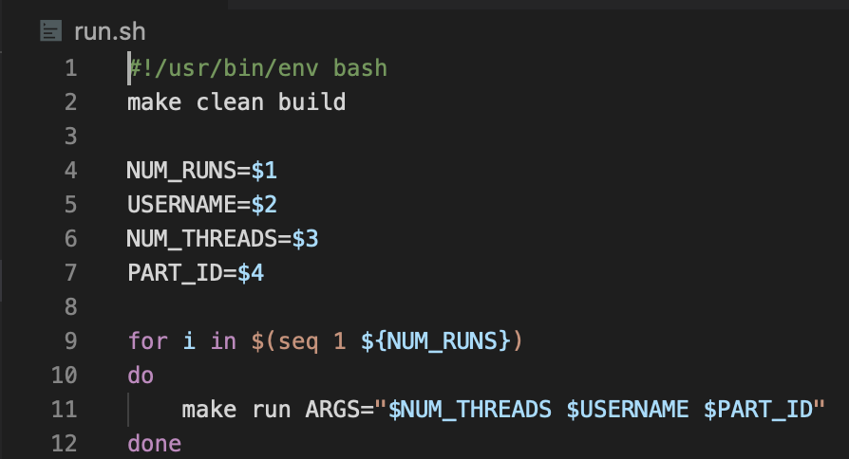
C++ Programming Assignment Makefile and run.sh
The Makefile has normal make targets, including one for creating an intermediate object file for the assignment code
The make run target is executed by the run.sh with the same 3 arguments as the Python 3 assignment
Notes:
There are two support files for the assignment.
One is the Makefile, with typical clean, build, run, all targets. There is an additional target for generating an intermediate object file, which is then used when build the executable.
The other is the run.sh, which is very similar to the run.sh for the Python 3 assignment, except that the arguments are passed without flags.

